Slide 1
Software Engineering
S.S. Satapathy
Dept. of CSE
TU

Slide 2
Definition
Engineering approach to develop software
OR
Systematic approach to develop software in a cost effective way
Unlike other disciplines of Engineering, Software engineering is not based on solid scientific principles, but based on experience of s/w developers. Therefore s/w engineering is continuously changing.

Slide 3
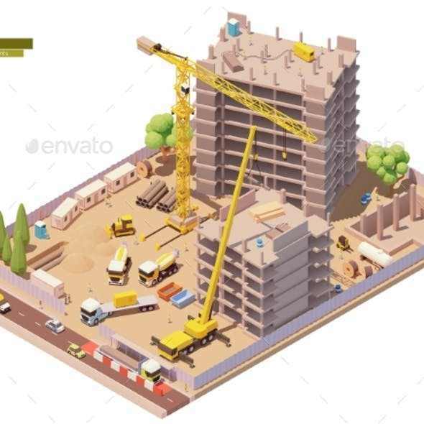

Program vs. Software
Program
  Written for personal problem solving
  For simple/single task/assignment
  Only a few people involved
  Written in one language
  Small in size
  Easy to use
  Little documentation
Software
  Written for general purpose problem solving
  For complicated task/assignment
  A large team of people involved
  Written in multiple language/packages
  Large in size
  Complex functionalities
  Heavy documentation

Slide 4
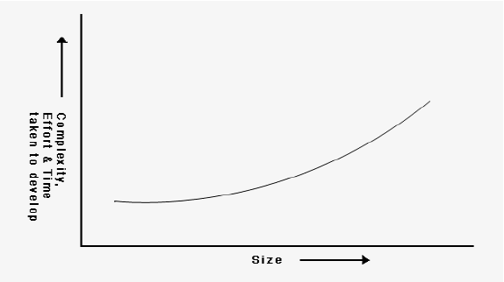
S/W size & effort required Relationship
Relationship between effort required to develop and software size is exponential. That is when size is large it becomes too complex to develop the software.
Software engineering helps reducing complexity in software development.

Slide 5
Software development is in Crisis
Over the years in software industry development complexity is growing very fast
  User requirements are increasing
  Amount of data available is increasing that need complex algorithm to analyze
  Available S/W tools/techniques are huge
  Software market is becoming too competitive

Slide 6
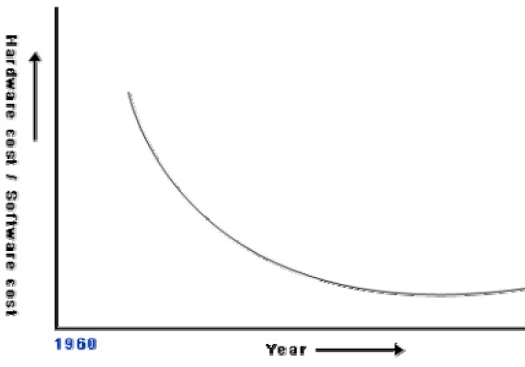
Causes of & Solutions for Software Crisis
Software crisis: Over the years, expenses on software purchases is huge compared to those on hardware purchases.
Huge software cost is due to ineffective development
Possible factors can be
  larger problem sizes
  lack of adequate training in software engineering
  increasing skill shortage
  low productivity
Solution: Use of software engineering practices

Slide 7
Software engineering principles use two techniques to reduce problem complexity
Abstraction
Decomposition

Slide 8
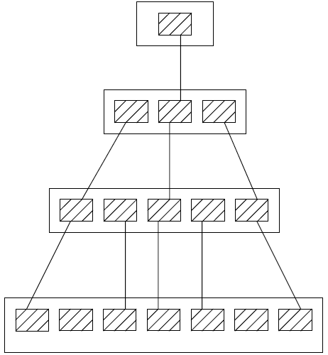
Abstraction
Simplify the problem by omitting irrelevant details.
Once the simpler problem is solved, then the omitted details can be taken into consideration to solve the next lower level abstraction, and so on…
3rd abstraction
2nd abstraction
1st abstraction
Full
Problem

Slide 9
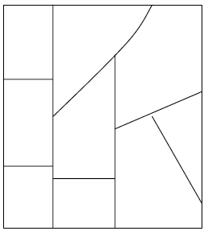
Decomposition
Divide a complex problem into several smaller independently problems and then solve the smaller problems are one by one
A good decomposition of a problem should minimize interactions among various smaller components.

Slide 10
Evolution of
Software Design Techniques
Exploratory Programming
Structured programming
Data structure-oriented design
Data flow-oriented design
Object-oriented design

Slide 11
Exploratory Programming (1950s)
Programs were written in assembly language
Programs were very small, about few hundreds of lines of assembly code
There was no systematic approach of writing programs, programmer were writing programs as per their own individual style

Slide 12
Structured programming (1960s)
High-level programming languages like FORTRAN, ALGOL, and COBOL etc came up for programming
Programmers started giving emphasis on program’s control flow structure
Basis of the structured programming methodology was established
  Only three programming constructs – sequence, selection, and iteration – are sufficient to express any programming logic.
  Avoid GOTO statement
Soon Languages like Pascal, C came up that facilitated writing programs with good control structure, that let to give emphasis on efficient data structure

Slide 13
Data structure-oriented design (1970s)
Designing efficient data structure was considered important for a good program.
That helped developing efficient programs in terms of optimum time and space requirement.

Slide 14
Data flow-oriented design (1970s)
Principle behind this design is that, to have a good program structure, one has to study how the data flows from input to the output of the program.
Every program reads data and then processes that data to produce some output.
Once the data flow structure is understood, it will be easy to derive the program structure.

Slide 15
Object-oriented design (1980s)
This is the most recent and commonly used technique.
It is based on a design approach in which natural objects (For example, in case of an organization, objects such as employees, pay-roll register, etc.) occurring in a problem are first identified. Each object essentially acts as a data hiding entity
Keeping relationship (such as composition, reference and inheritance) among objects in view program structures are determined.

Slide 16
Exploratory Style vs. Modern Style of Software Development
Sl. | Exploratory/ Earlier style | Modern style
1 | Software development process purely depends on the developer | Development of a software product is very much systematic and disciplined
 | based on error correction | based on error prevention
2 | coding was considered synonymous with software development | coding is regarded as only a small part of the overall software development activities several development activities such as design and testing which typically require much more effort than coding
3 | Software are poorly designed | Software development process is properly documented.
Several models of software development processes were/are used in software industry

Slide 17
Job of Modern S/W Developer is Difficult
Dealing with the Users
  Ill defined requirements in many cases
  Concerns with ease-of-use and response time
Dealing with the Technical People
  Concerns with the code, database design, file/data structures
Dealing with Management
  Concerns with the returns on the investment
  Cost benefit analysis
  Schedule

Slide 18
Apply Engineering Approach for
Attempt to estimate cost/effort
Plan and schedule work
Involve users in defining requirements
Identify stages in development
Define clear milestones so that progress can be measured
Schedule reviews both for control and quality
Define deliverables
Plan for extensive testing

