Slide 1
Software Engineering
S.S. Satapathy
Dept. of CSE
TU

Slide 2
Agile Methodology
In order to overcome difficulty in using too much rigid waterfall model, a group of 17 experts presented Agile manifesto for S/W development (https://agilemanifesto.org/).
The Agile manifesto is based on 4 values and 12 principles
Agile methodology only presents a philosophy and allows different implementations
  Some of the implementations are Kanban, Extreme Programming (XP) and Scrum
  Out of these Scrum is very popular in S/W industry

Slide 3
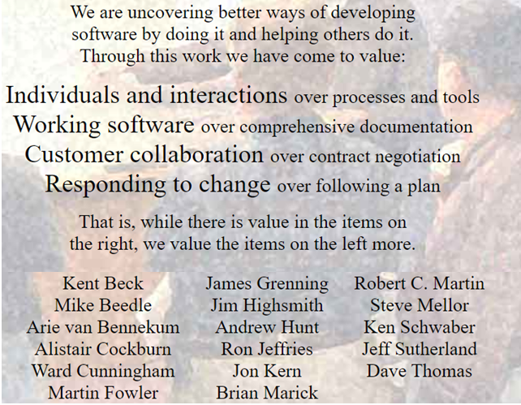
Values
Brains behind the manifesto

Slide 4

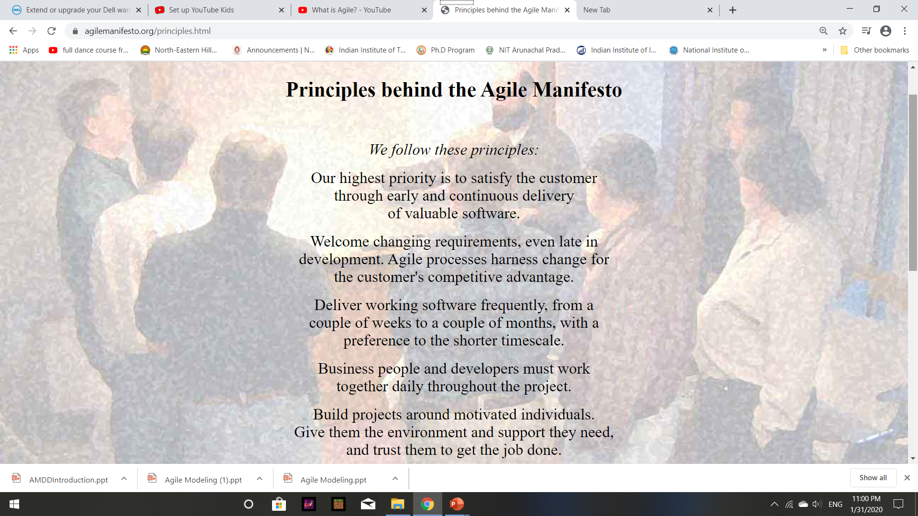
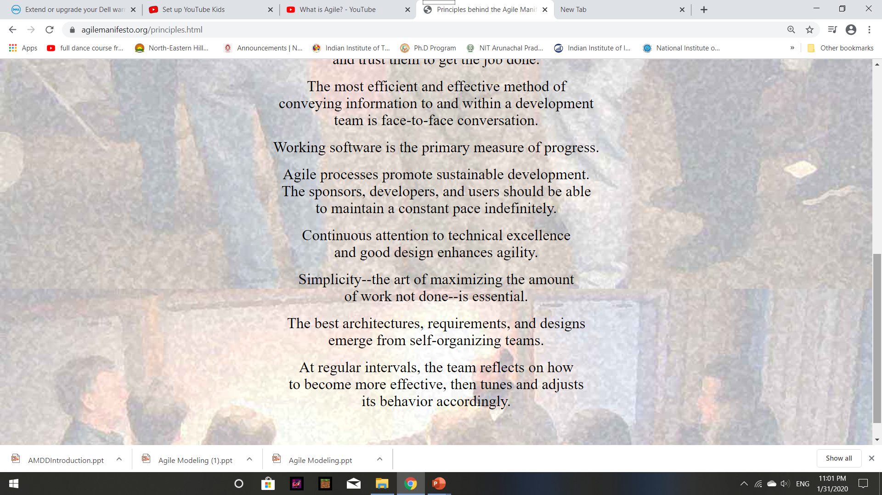

Slide 5
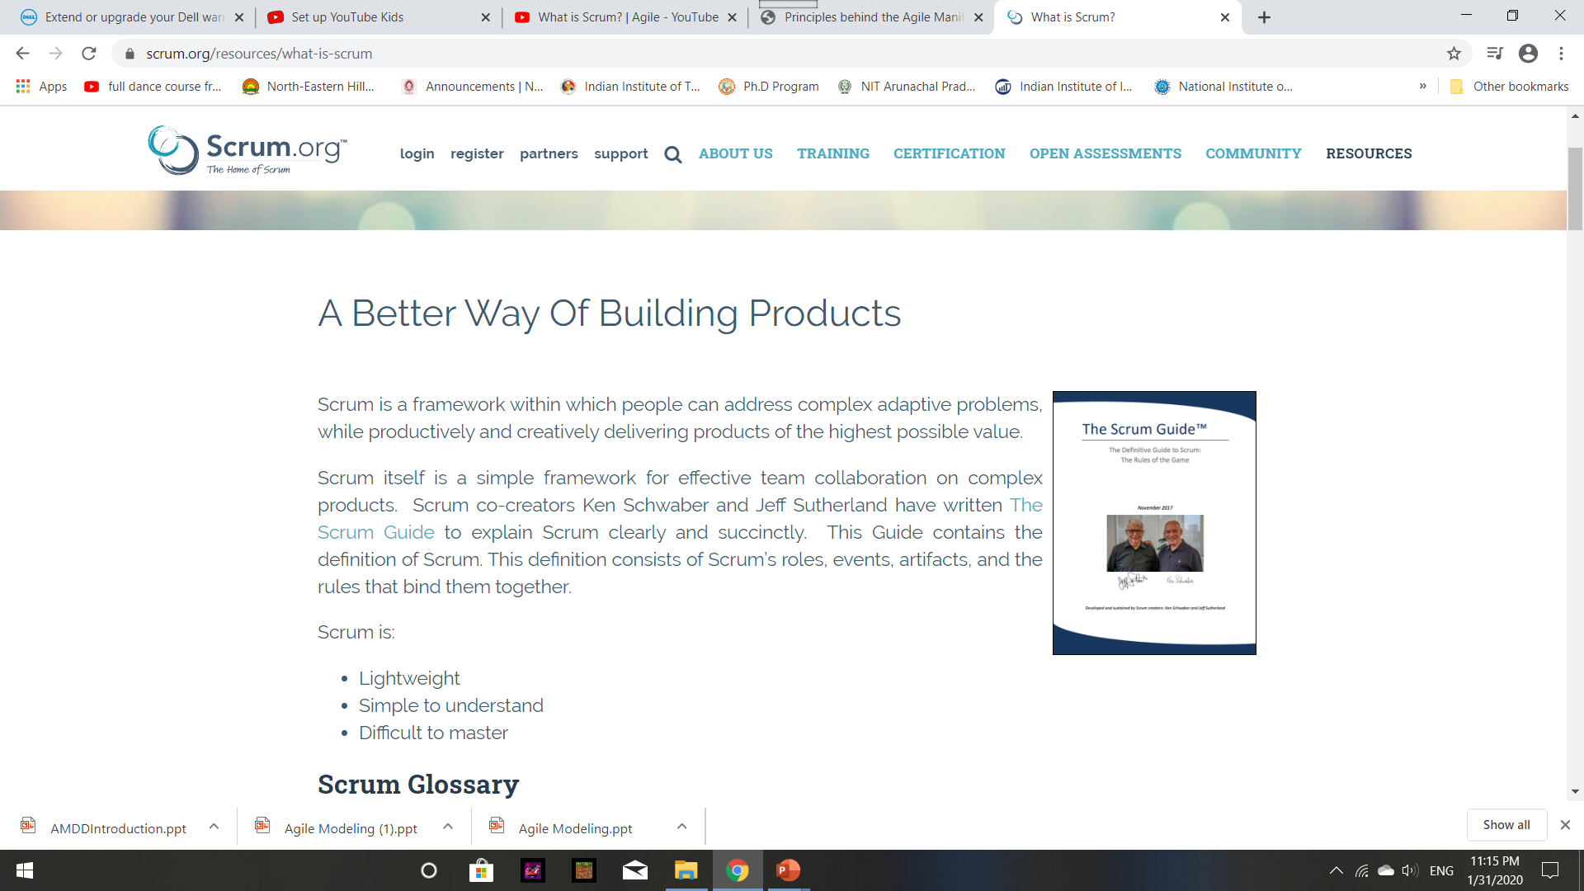
Scrum (https://www.scrum.org/)

Slide 7
Scrum
Agile development methods break product development work into small increments that minimize the amount of planning and design called iterations or sprints.
Iterations, or sprints, are short time frames (timeboxes) that typically last from one to four weeks.
Each iteration involves a cross-functional team working in all functions: planning, analysis, design, coding, unit testing, and acceptance testing.

Slide 8
Scrum
At the end of the iteration a working product is demonstrated to stakeholders.
  This minimizes overall risk and allows the product to adapt to changes quickly.
An iteration might not add enough functionality to warrant a market release, but the goal is to have an available release (with minimal bugs) at the end of each iteration.
Multiple iterations might be required to release a product or new features. Working software is the primary measure of progress.

Slide 9
Scrum
User Stories:
  In consultation with the customer or product owner, the team divides up the work to be done into functional increments called "user stories."
  Each user story is expected to yield a contribution to the value of the overall product.
Daily Meeting:
  Each day at the same time, the team meets so as to bring everyone up to date on the information that is vital for coordination:
    each team members briefly describes any "completed" contributions and any obstacles that stand in their way.

Slide 10
Scrum
Incremental Development:
  Nearly all Agile teams favor an incremental development strategy
  Each successive version of the product is usable, and each builds upon the previous version by adding user-visible functionality.
Iterative Development:
  Agile projects are iterative
    as they intentionally allow for "repeating" software development activities, and for potentially "revisiting" the same work products.

Slide 11
Scrum
Incremental Development:
  Nearly all Agile teams favor an incremental development strategy;
  Each successive version of the product is usable, and each builds upon the previous version by adding user-visible functionality.
Iterative Development:
  Agile projects are iterative
    as they intentionally allow for "repeating" software development activities, and for potentially "revisiting" the same work products.

Slide 12
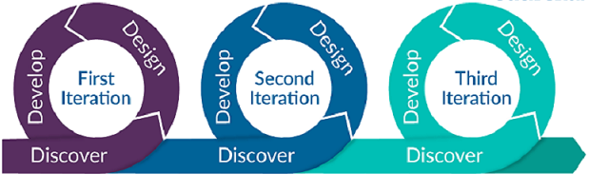
Agile Summary
Because requirements keep on changing from time to time Agile methodology is a better approach.
Agile methodology allows continuous iteration of concurrent development and testing throughout the software development life cycle of the project.
Agile approach brought agility to development, but lost on Operations which did not come up to speed requirement in software industry.

