Slide 1
Software Engineering
S.S. Satapathy
Dept. of CSE
TU

Slide 2
DevOps
Broadly software industry activities can be categorized in to two types: Development and Operation
Development (Creating S/W product): It is more about developing the software by Business analyst, System analyst, Developers, Tester, etc.
Operations: It’s more about providing required infrastructure necessary of Development and testing. This domain can have roles like IT Technician, system Admin, Help desk engineer etc.
DevOps : This new development culture recently emerged in IT industry for better coordination between the two teams for quality software development.

Slide 3
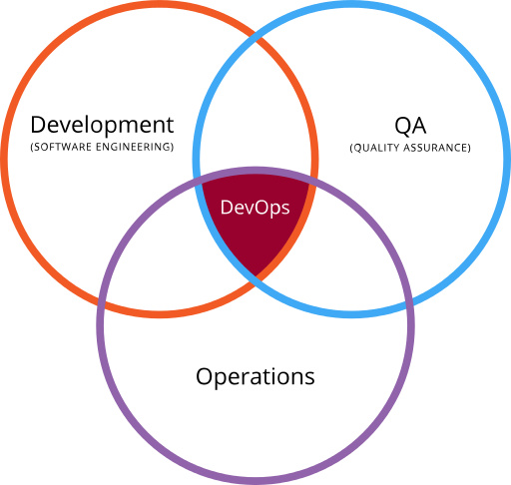
DevOps
DevOps is the intersection of development (software engineering), operations and quality assurance (QA)

Slide 4
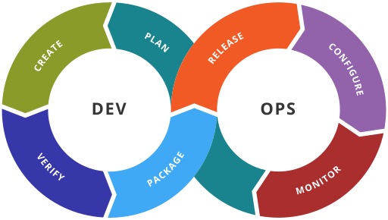
DevOps Tool chain
Stages in a DevOps tool chain

Slide 5
DevOps
DevOps is a software engineering culture and practice that aims at unifying software development (Dev) and software operation (Ops).
The main characteristic of the DevOps is to
  automation and monitoring at all steps of software construction, from integration, testing, releasing to deployment and infrastructure management.
DevOps aims at shorter development cycles, increased deployment frequency, and more dependable releases, in close alignment with business objectives.

Slide 6
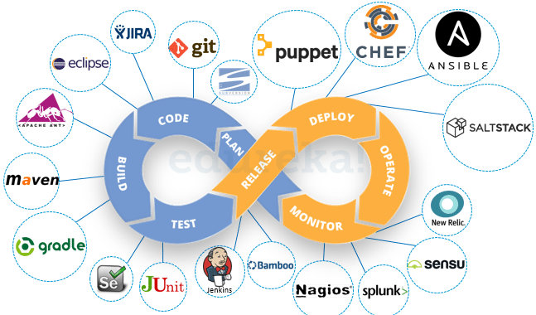

Slide 7
DevOps Tool Chains
As DevOps is a cross-functional mode of working:
  rather than a single DevOps tool there are sets (or "toolchains") of multiple tools.
Such DevOps tools fit into one or more of these categories, reflective of key aspects of the development and delivery process:
  Code — code development and review, source code management tools, code merging
  Build — continuous integration tools, build status
  Test — continuous testing tools that provide feedback on business risks
  Package — artifact repository, application pre-deployment staging
  Release — change management, release approvals, release automation
  Configure — infrastructure configuration and management, Infrastructure as Code tools
  Monitor — applications performance monitoring, end–user experience

