Slide 1

MODERN CONCEPT
OF
MANAGEMENT

Slide 2


ANCIENT
MODERN

Slide 3
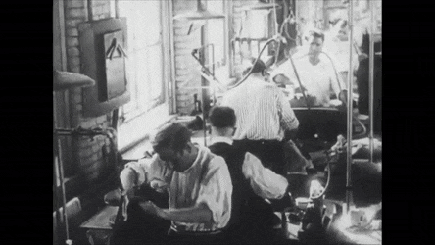

PAST
PRESENT

Slide 4


Slide 5


Slide 6


Slide 7


Slide 9
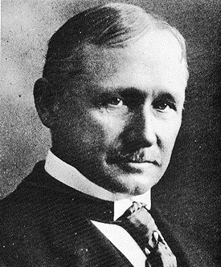
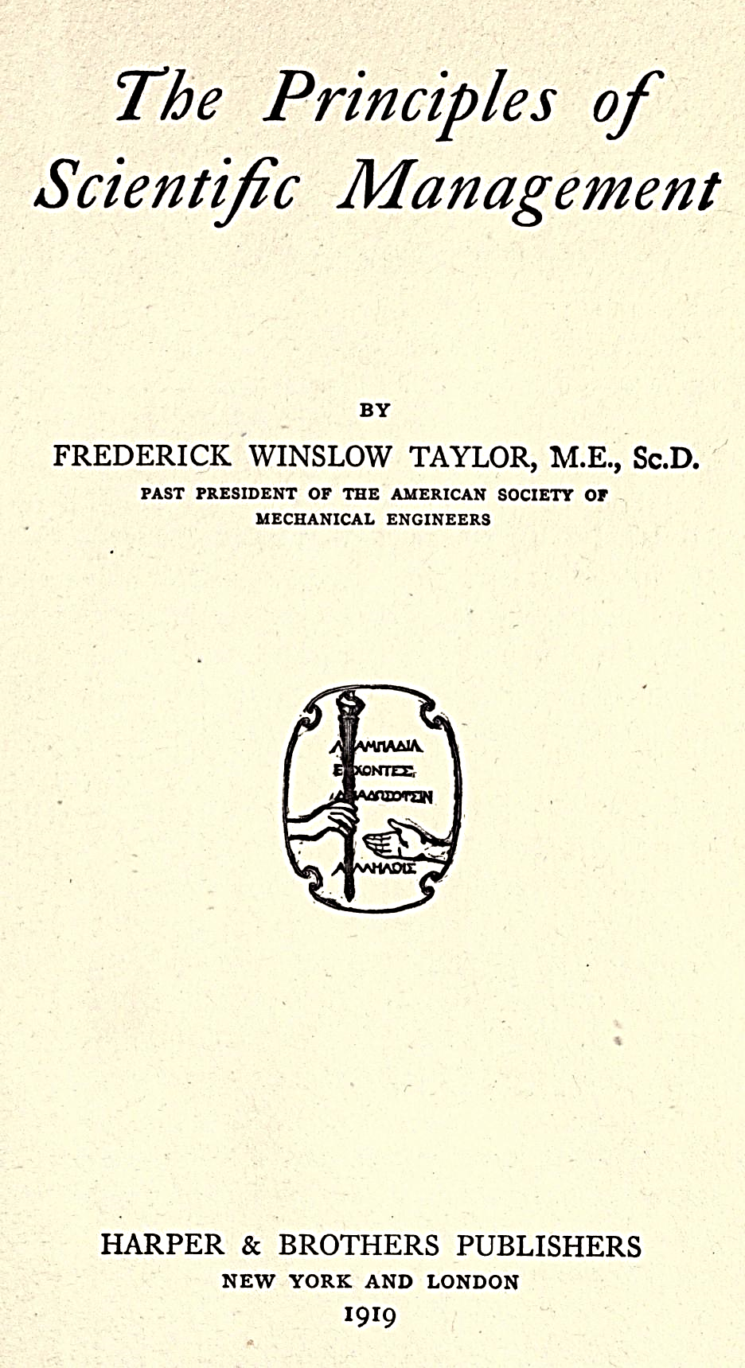

Slide 10
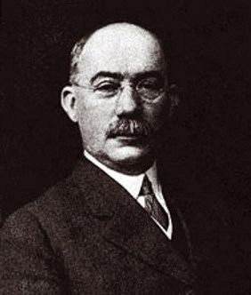
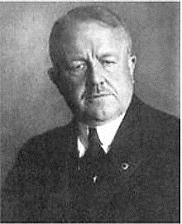
Henry L. Gantt (1861-1919),
Frank Gilbreth (1868-1924),

Slide 11
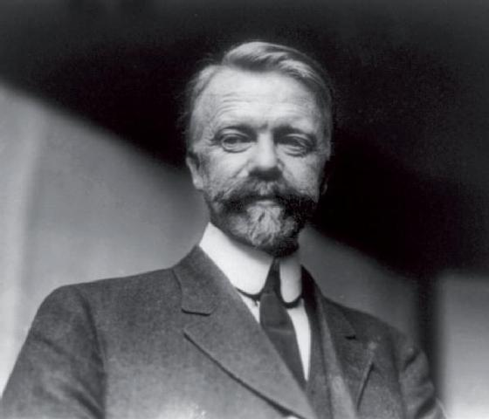
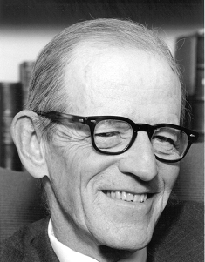
Henry Fayol (1841-1925)
Elton Mayo

Slide 12


Slide 13
R. C. Appleby's definition of management.
Management may be considered as a "process whereby a suitable environment is created for effort to be organized to accomplish desired goals". It is, therefore, a social process "entailing responsibility for the effective and economical planning and regulation of the operations of an enterprise, in fulfillment of a given purpose or task".

Slide 14


Slide 15


Slide 16


Slide 17


Slide 18


Slide 19


Slide 20


Slide 21


Slide 22


Slide 23


