Slide 1
MA401 Comparative Education
Department of education, Tezpur University
By
Soumyabrata Mahapatra

Slide 2
1. To acquaint the students with educational systems in terms of factors and approaches of comparative education
3. To orient the students to assess the efficacy of educational systems of various countries.
4. To develop an understanding among the students to solve the prevailing problems of education in India through the discipline of education.

Slide 3
Unit2. Approaches & Methods
Approaches Refers to the theoretical framework of Comparative education through which problem or concept can be drawn, graph or solution or investigation can be plan Refers to the direction or angle though which nature of variables or phenomenon regarding comparative education can be lensed Approaches have to be decided or planed before selecting the methods It is the foundational assumption that assumed or premised to be true | Methods 1. Practical aspects through which aim of investigation can be executed, achieved, hypotheses can be tested or problem can be answered, work can be projected, plan can be implemented or actioned. 2. Refers to the process through which steps or directions can be practiced for achieving the goal. 3. Methods can be selected after planning the approaches. 4. It is the way which foundational assumption can be validated or verified by undertaking research.

Slide 4
Approaches and Methods of comparative education in the light of research paradigm:
4. The approach of studying, investigating comparative education is quite similar to the approach of research methodology
3. This similarity can be traced and discussed through the analysis of research paradigm or world views
2.Educational phenomenon, variables, problems or concern can be understood, investigated or solved through the Disciplinary, multidisciplinary, interdisciplinary and transdisciplinary approaches of research
Idea of comparative education can be traced back to the history of revolutionary thinking which can be understood through the discission of critical theory, liberalization, existentialism, progressivism and the practice of pragmatism in each and every aspects of life where sense of revolution and development reached only by Education

Slide 5
Approaches
Qualitative approaches
Quantitative approaches
Historical
Philosophical
statistical
scientific
Cross-cultural/global

Slide 6
Qualitative approaches
Quantitative approaches
Specific considerations are needed as we explore the educational phenomenon involving issues, policies, process and practice in global settings.
Specific consideration are needed when we explain the issues or variables involving practices and policies addressing educational challenges in global settings. This approach naturally employ statistical, experimental literacy to map the reality behind problems.
Philosophical
Cross cultural
statistical
scientific
Historical

Slide 7
Qualitative approaches :
Historical Approach
Reconstructing educational historical development right from the first day when education was introduced into the place and the time of study. This approach will enable the researcher to identify the factors that are responsible for the current educational system of the country being studied. However, the problem with this approach is that greater emphasis is always placed on the past.

Slide 8
Philosophical approach:
This approach will enable the researcher to identify, understand and restructure the factors responsible for the ideological foundation of educational system of the countries like philosophical frameworks of curriculum, aims of education, Teaching methodologies for teaching learning.
Cross cultural:
This is an approach whereby all the variations existing from one area to another within the same or different ethnographic boundaries of the countries are taken into consideration while comparing the system of education of a foreign country with one’s educational system.

Slide 9
Quantitative approaches:
Statistical approach:
In this approach investigator will have to describe everything he finds on ground. Number of schools, student enrolment, number of teachers, number of the school buildings including classrooms as well as the number of subjects being offered. The numerical and graphical representation and reflection is needed to explain the variables of Educational context.

Slide 10
Scientific approach:
This is an approach in which the study of comparative education is carried out empirically by formulating hypotheses, defining the important concepts, setting out the variables as well as the conditions for establishing the validity of the hypotheses formulated. Since in any scientific research, data collection its interpretation with the help of statistics of analysis are very important,. These must not also be lacking in the study of Comparative Education to enhance the quality and credibility of whatever may be the result of the investigation.

Slide 11
A detailed review of the role of the different actors (parents, practitioners, policy makers, international educational bodies & academics) in comparative education:
1. Parents:
Selection of schools/institutions for their students,
Involving in educational system
Undertaking cases study on the home activities of their children
Associating school process by taking the membership of management committee.
Making Continuous communication with school counselor, teachers, administrators for recording and observing students performance/ curricular activities.

Slide 12
2. Practitioners
Associating teaching, learning and assessment procedure in education
2. Reviewing the school process and suggesting administrator, personnel for bringing optimal outcome in education
3. Reviewing international/ global scenario of education and the getting involve by active participation in seminar, conference, symposium, workshop, research works to achieve optimal development.
4. Suggesting functionaries for designing and practicing flexible, outcome based curriculum.

Slide 13
3. Policy Makers
Designing policy/ plan for curriculum of education, teaching strategies, instructional input mechanism, assessment tools & techniques, evaluation procedure
Analyzing /reviewing educational issues and demands across the globe
Considering psychological, economical, sociological , cultural, scientific, technological factors while designing policy or curriculum for education.
Designing learning management systems (LMS) which is cross culturally accepted
Considering and accepting the diversified environmental factors while fixing the modalities of education.
Planning for cost benefits analysis while budgeting expenditure for education
Planning for employability of curriculum
Involving stakeholders, community peoples, ingenious people, experts while making policy.

Slide 14
Educational Bodies:
Planning and implementing policy of education
Installing implementation strategies for policy
Recognizing, affiliating and accreditation educational institutions
Undertaking focus group discussion for analyzing the issues in education and its resolving way
Undertaking research in global settings for reviewing policy and ensuring implementation
Developing learning management system and resources
Guiding institution in teaching learning, assessment & evaluation, research activities, conducting workshops, capacity building programme for professional development of teachers, symposium and others professional curricular activities

Slide 15
Unit 4.Critical Study of Other Educational Programmes:
Quality and internationalization of Higher Education.
Key elements of Internationalization of Higher Education:
International Reputation of educational institutions
MoU/International Collaboration
Inbound and outbound students; mobility
Quality parameters
Educational planning and management
Public expenditure in Education

Slide 16
No. and quality of research and publication
Status of Productivity by research contribution
Use of GDP in Education
Cybersecurity
Technological advancement and digital economy based Educational Programme
Cross-cultural/global exposure of education
Employability of course and curriculum
Educational, medical, economic benefits/opportunities giving with course/degrees.

Slide 17
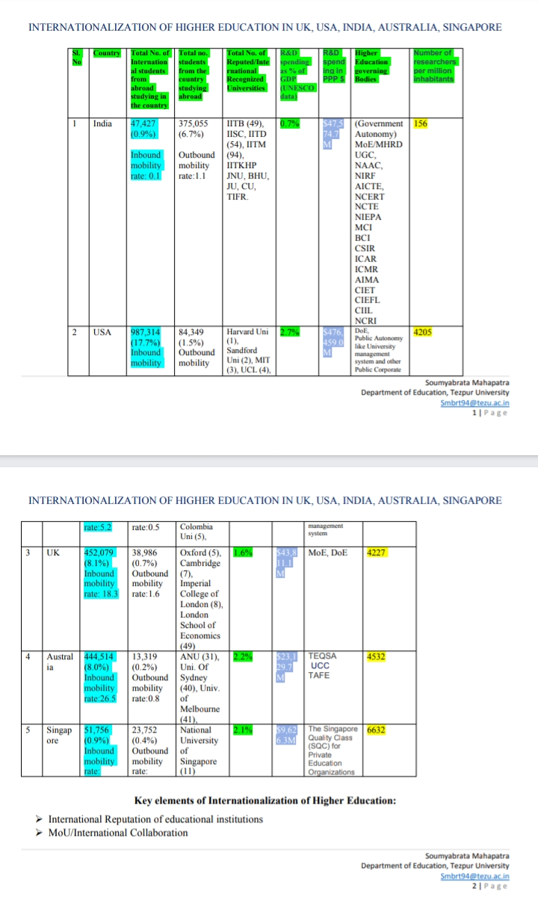

Slide 18
https://drive.google.com/file/d/1VSsSesFw8wid8t7JcYz0xmeyX_EFVnGx/view?usp=drive_web&authuser=0
https://drive.google.com/file/d/14s7FZa-4-fTeQR11OpFQISsAMyGRIF4I/view?usp=drive_web&authuser=0
https://drive.google.com/file/d/1_-Wi3AZ4l_aPr5S5fjfqeyCL-s6BgLND/view?usp=drive_web&authuser=0

